Slide 1
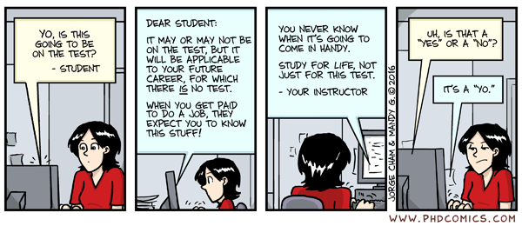
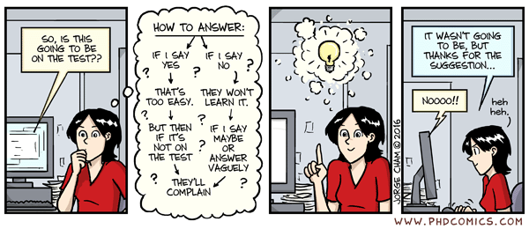
Comic of the day

Slide 2

CSE 102 - COMPUTER PROGRAMMING II Final Exam Information
Joseph LEDET
Department of Computer Engineering
Akdeniz University
josephledet@akdeniz.edu.tr

Slide 3
Outline
Exam format
Review material
Questions

Slide 4
DATE/TIME/LOCATION
Date
Tuesday 11-June-2024
Time
09.00
Location
Amfi3, BB01, D205

Slide 5
GRADING INFORMATION
100 points
Represents 40% of Final grade

Slide 6
Topics Covered
All topics discussed in class
Everything from beginning of semester to Midterm Exam
Text
Generics
Data Structures
Sets and Maps
Topics from previous courses
Topics not discussed, but slides are available
Efficient Algorithms
Sorting

Slide 7
Format
Quick Answer Questions
Multiple Choice
True/False
Matching
Program Flow
What is the output of a loop/method?
What is the return value of a method?
Will an Exception occur?
Implement a System/Class/Method
UML diagram
Write code

Slide 8
Multiple choice
What will be the value of the following expression?
1 + 2 * 3 + 4
11
11.0
13
13.0
None of the above

Slide 9
Multiple choice
The values passed to a method are called the method’s ______________.
return values
arguments (or parameters)
local variables
identifiers
iterators

Slide 10
True/False
always
A method must always return a value. -> false
The methods println() and next() are useful methods for displaying output to the screen and gaining input from the user and can be used in a program using the System.out and Scanner classes, respectively. -> true
!true -> false
i++ == ++i -> evaluates as false
++i == i++ -> evaluates as true

Slide 11
Matching
Item | Definition
1) /* | A. Logical AND
2) && | B. Begins a comment
3) // | C. Test for equality
4) = | D. Assigns a new value
5) ==

Slide 12
What is the output?
Able to tell what the value of a variable will be at various points
Able to tell program flow through
if-else statements
Loops
Exceptions
finally always executes

Slide 13
Short program fragment
Write a short fragment to do some task
Know how to
Write a method
Use recursion or iteration
Throw an exception
Use the methods (including constructors) of a parent class
Use a Set or a Map or other data structure

Slide 14
Develop a System
Determine sub-problems
Analyze a UML diagram
Implement in Java code
Example
A University that has Teachers, Students and Courses

Slide 15
FINAL NOTE
Closed
Book
Notes
Phone
Computer
Electrical Devices
Mouth
Open
Mind
1 “Notes Sheet” is allowed
Size A-4 paper (1)
Must be handwritten
Anything printed/photocopied will be not counted

Slide 16
Questions
[?]

